Slide 1


Slide 2

Forecasting the Effect of Lockdown Measures on the Spread of the Covid-19 Infection
December 20, 2022
Presented by:
Piyush Adya
Department of Computer Science

Slide 3

Table of Content
Introduction
Background and Related Work
Research Methodology
Tech Stack
Results
Limitation
Validation
Future work
Conclusion

Slide 4

Introduction

Slide 5
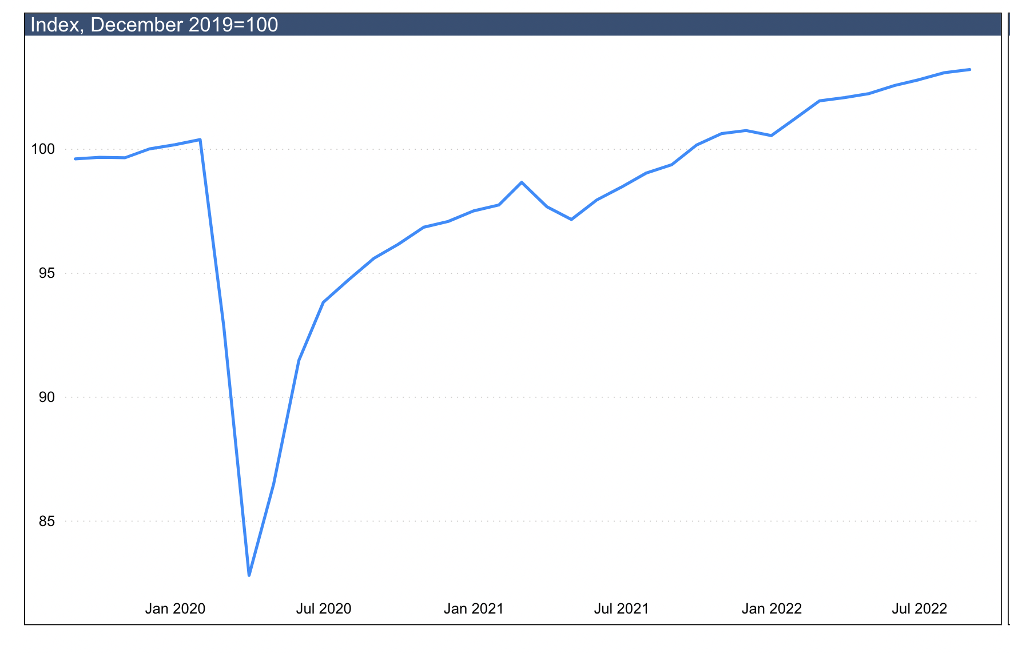
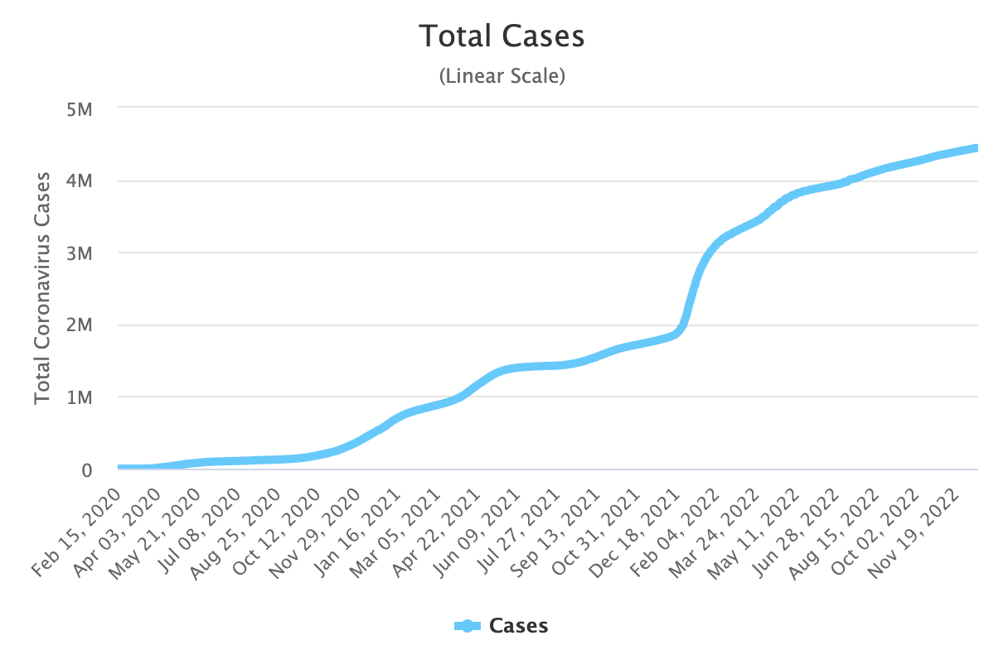
Introduction
Coronavirus Disease 2019 (COVID-19) had killed 6.6 million persons and infected over 652.2 million people.
In Canada total of 48,133 persons died and a total of 4.4 million people got infected with the COVID-19 virus.
There has been health, economic, and social impact, etc. due to the pandemic.
Governments and policymakers must be able to quickly make an informed decision by analyzing all possible impacts of various lockdown measures that can effectively reduce the spread of the virus and the decline of the economy.
Impacts of COVID‑19 on economic activity in Canada. [Reference]
Daily Confirmed COVID-19 Cases in Canada [Reference]

Slide 6
Background and Related Work

Slide 7
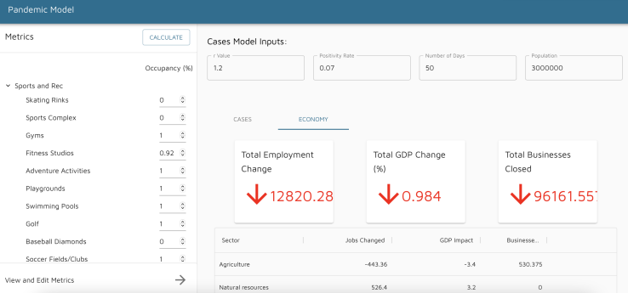
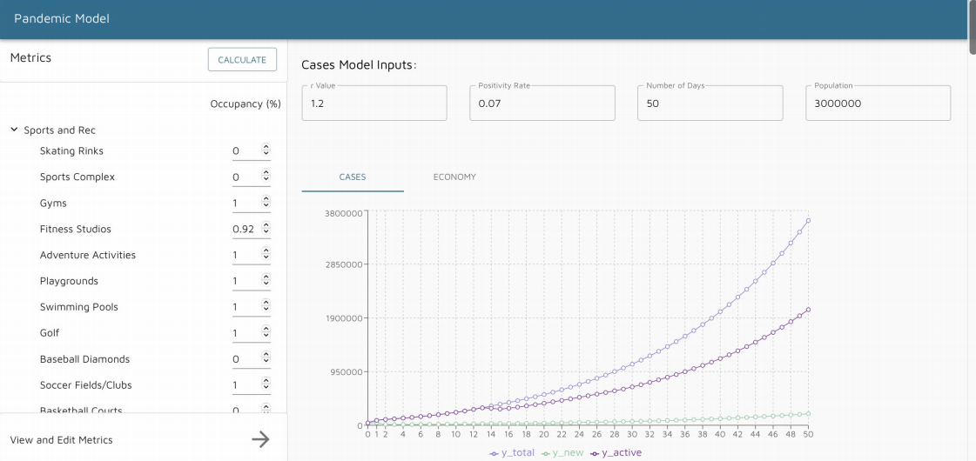
Previous Prototype
Foundation was developed by three students led by Prof. Anwar Haque (Kwan, 2021; Bhatt, 2021; Lou, 2022)
Limitations:
Accuracy of Model: Less accuracy, due to less real-world historical Covid-19 data.
Performance: Data was stored in CSV Files.
Economy Aspect: Based on math formula assumptions.

Slide 8
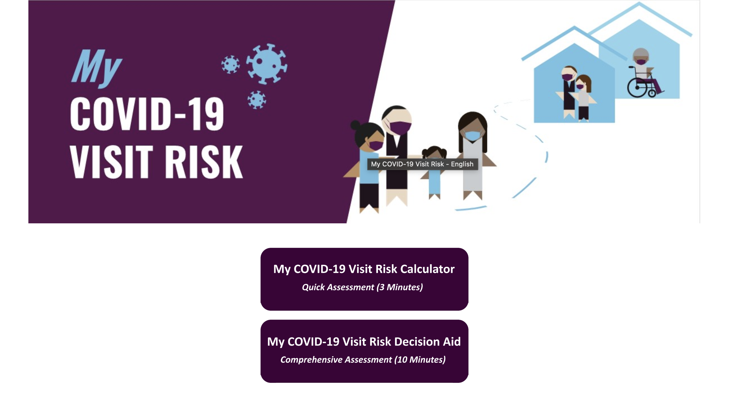
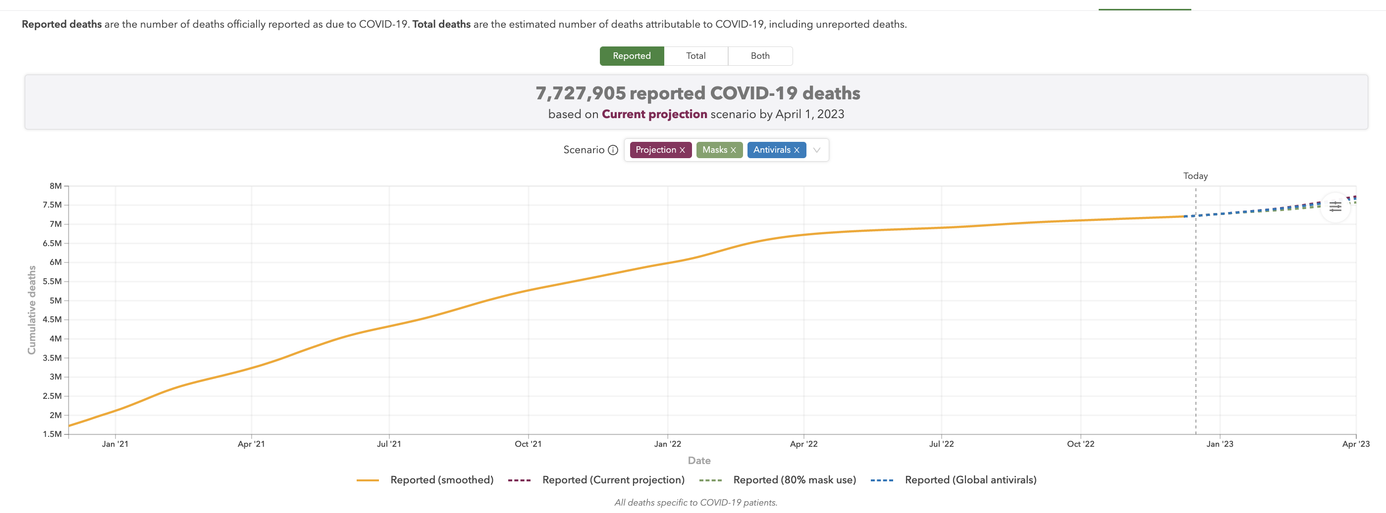
Related tools in the Field
My COVID-19 Visit Risk (Ryerson University, 2021-2022)
IHME COVID-19 Projections (Institute for Health Metrics and Evaluation, 2022)

Slide 9
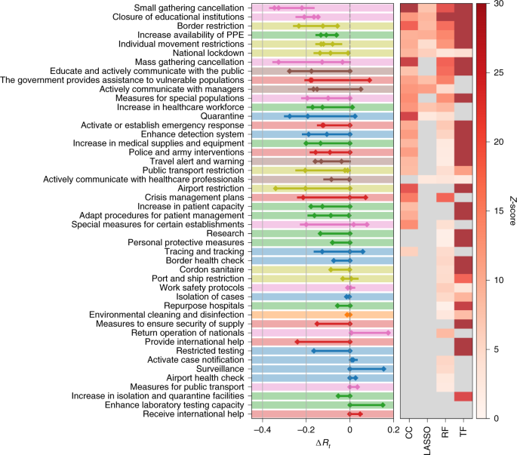
Effectiveness of Non-pharmaceutical Interventions (NPIs)
NPI effectiveness were ranked across 79 different territories (Haug et al., 2020)
Small gathering cancellation
Closure of educational institutions
Border closures
Increase Healthcare capacities
Individual movement restrictions
National Lockdown
Six most effective NPIs:

Slide 10
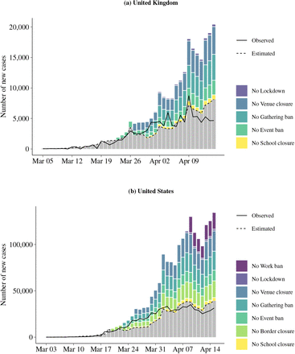
Effectiveness of Non-pharmaceutical Interventions (NPIs) Continued…
Impact of non-pharmaceutical interventions on documented cases of COVID-19(Banholzer et al.,2020)

Slide 11
Research Methodology

Slide 12
Research Methodology
Research and collect real-world historical COVID-19 dataset of Canada(Resouces-covid19 Canada) to implement a Machine Learning model to predict daily new infection cases.
Analyze and collect the correlation between NPIs and infection rates.
Integrate the results above into the prototype between frontend and backend using React.Js, Python and MySQL .

Slide 13

Research Methodology (Pre-Processing Steps)
Raw Dataset
Remove unnecessary columns
Remove Variants
Considering Delta, Omicron variant cases
Remove Outliers
Remove noise and helps prediction
Cleaned Data
Ready to train ML model

Slide 14
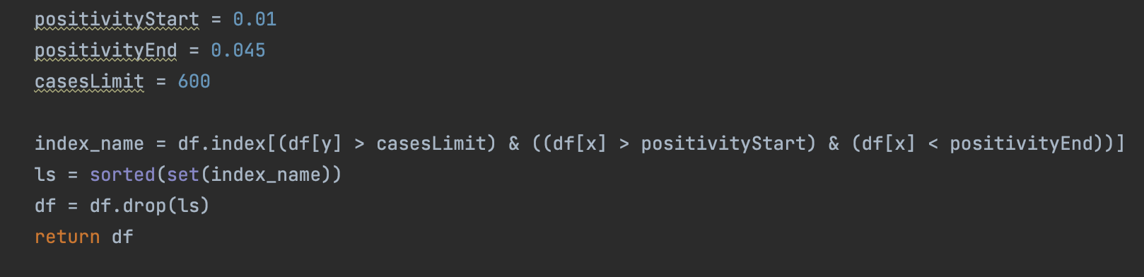
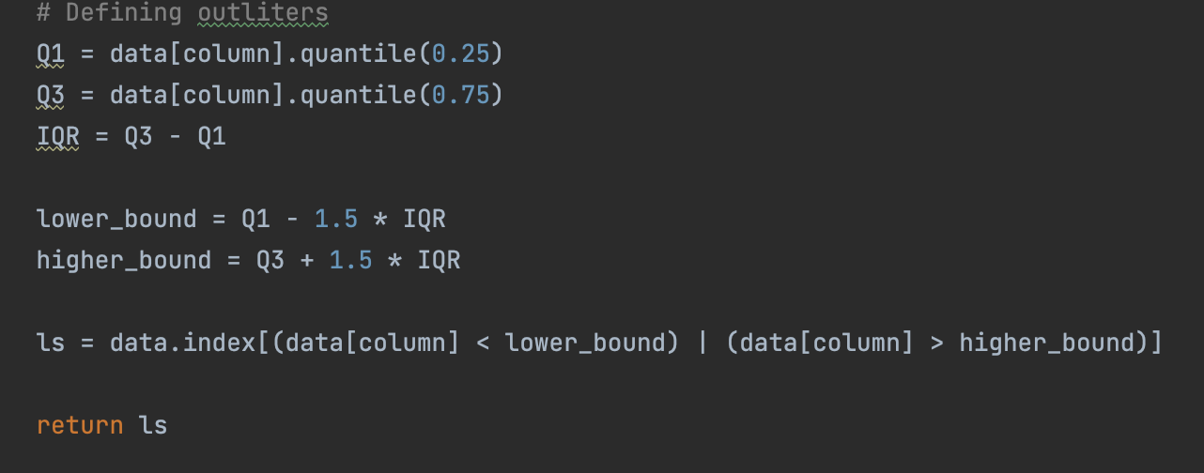
Research Methodology (Data Cleaning)
Remove Variants
Daily new cases above 600 with a positivity rates between 0.01 – 0.045 was removed, as those cases are likely due to the other variants.
Remove Outliers
Using the quantile outlier detection technique, the calculated outliers were removed to avoid noise and better improve model accuracy.
Algorithm to remove variants
Algorithm to remove outliers

Slide 15
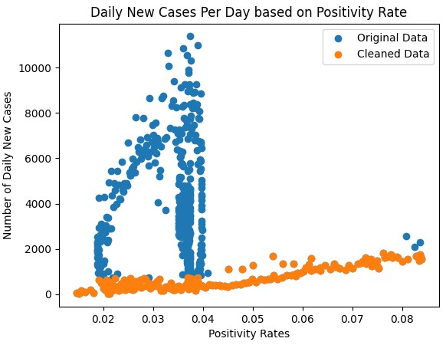
Original Data VS Cleaned Data

Slide 16
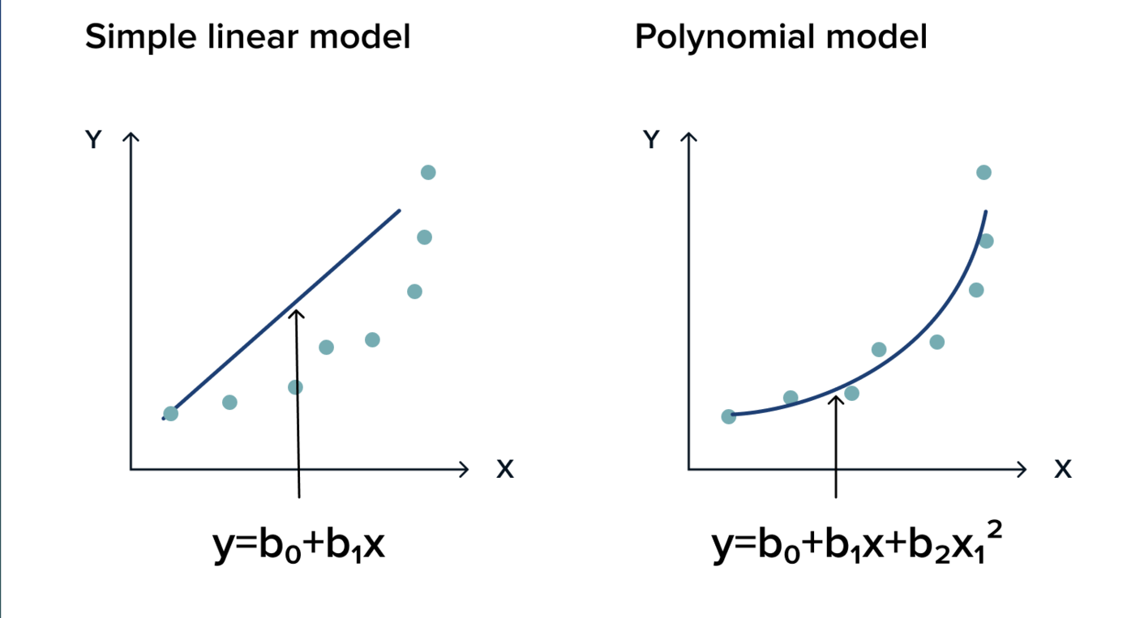
Research Methodology(ML model)
Polynomial Regression ML model
Input: Positivity rate
Output: Daily new infection cases
Positivity rate = Number of Confirmed Covid-19 cases/Number of tests

Slide 17
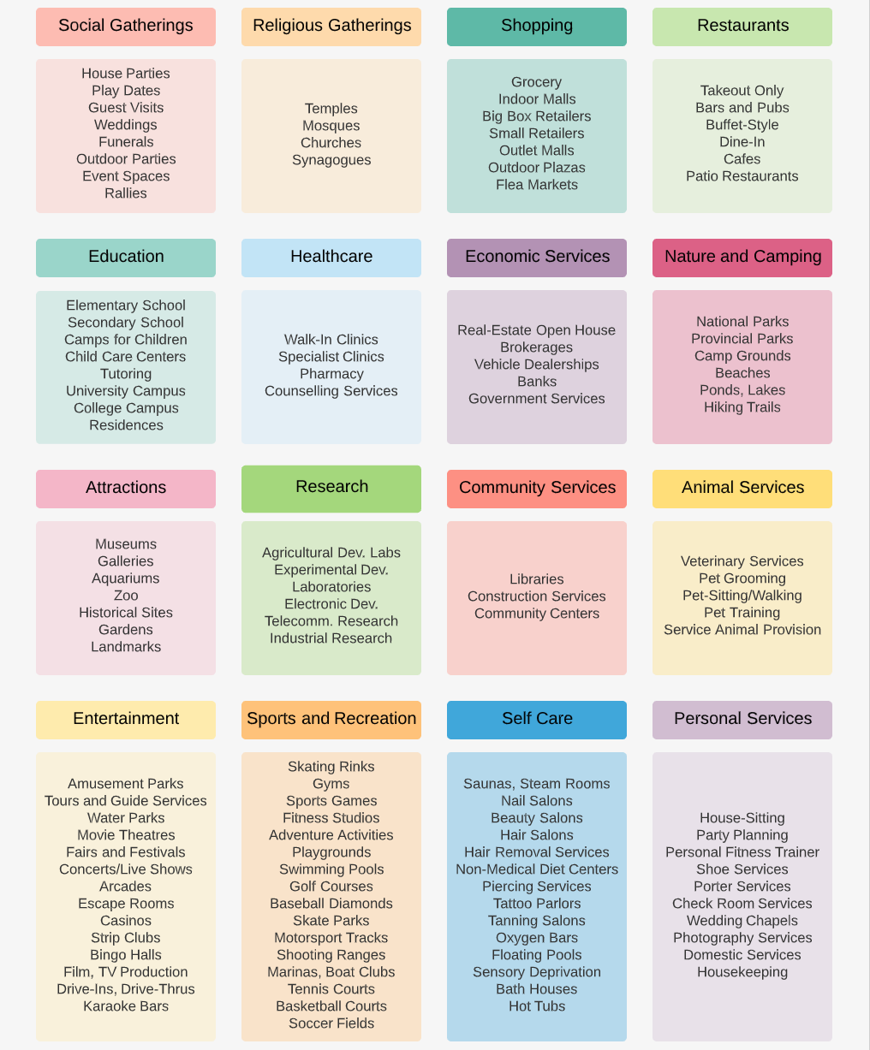
Research Methodology
Determine the association between each NPI and the number of daily new infection cases
Example: Closing down schools can reduce daily new infection cases by 8%

Slide 18
Tech Stack

Slide 19
Tech Stack
Python
React.JS
MySQL
Scikit-Learn
GitHub

Slide 20
Results

Slide 21
Key Results Obtained
ML Model
Correlation Data
Working Prototype
Predicts Daily New Covid-19 Cases
Between NPIs and COVID-19 Infection Risk
Visualize the Impact of Various NPIs on Infection Cases

Slide 22
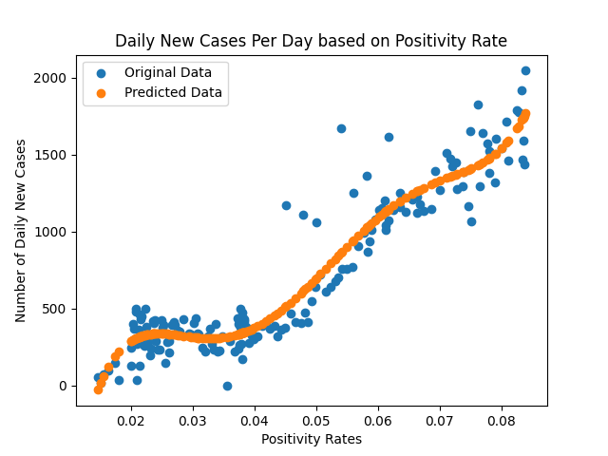
Results (ML Model )
Used Polynomial Regression Model
Input variable (x):
Positivity Rate
Output variable (y):
Number of Daily New Covid-19 Cases
Degree of Polynomials:
5
Resulting in 90.577% accuracy rate

Slide 23
ML Model Flowchart
Input
(Positivity Rate)
Polynomial transform
Linear Regression
Output
(Predicted Daily New Infection Cases)
Saved trained model (in .sav extension) using Pickle library

Slide 24
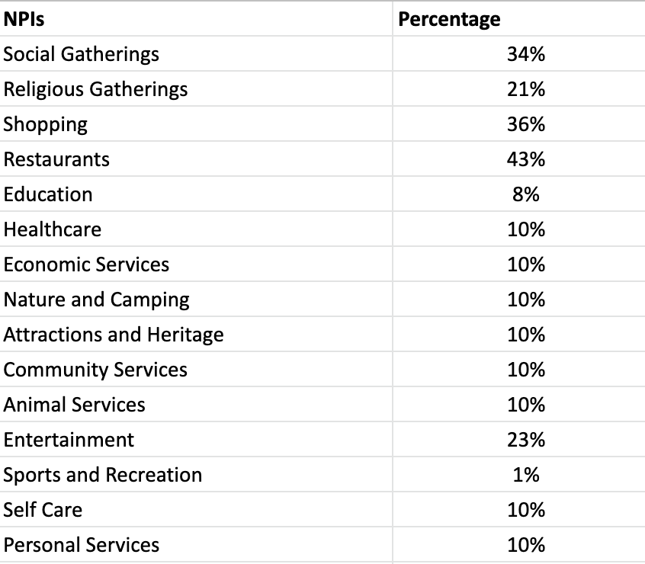
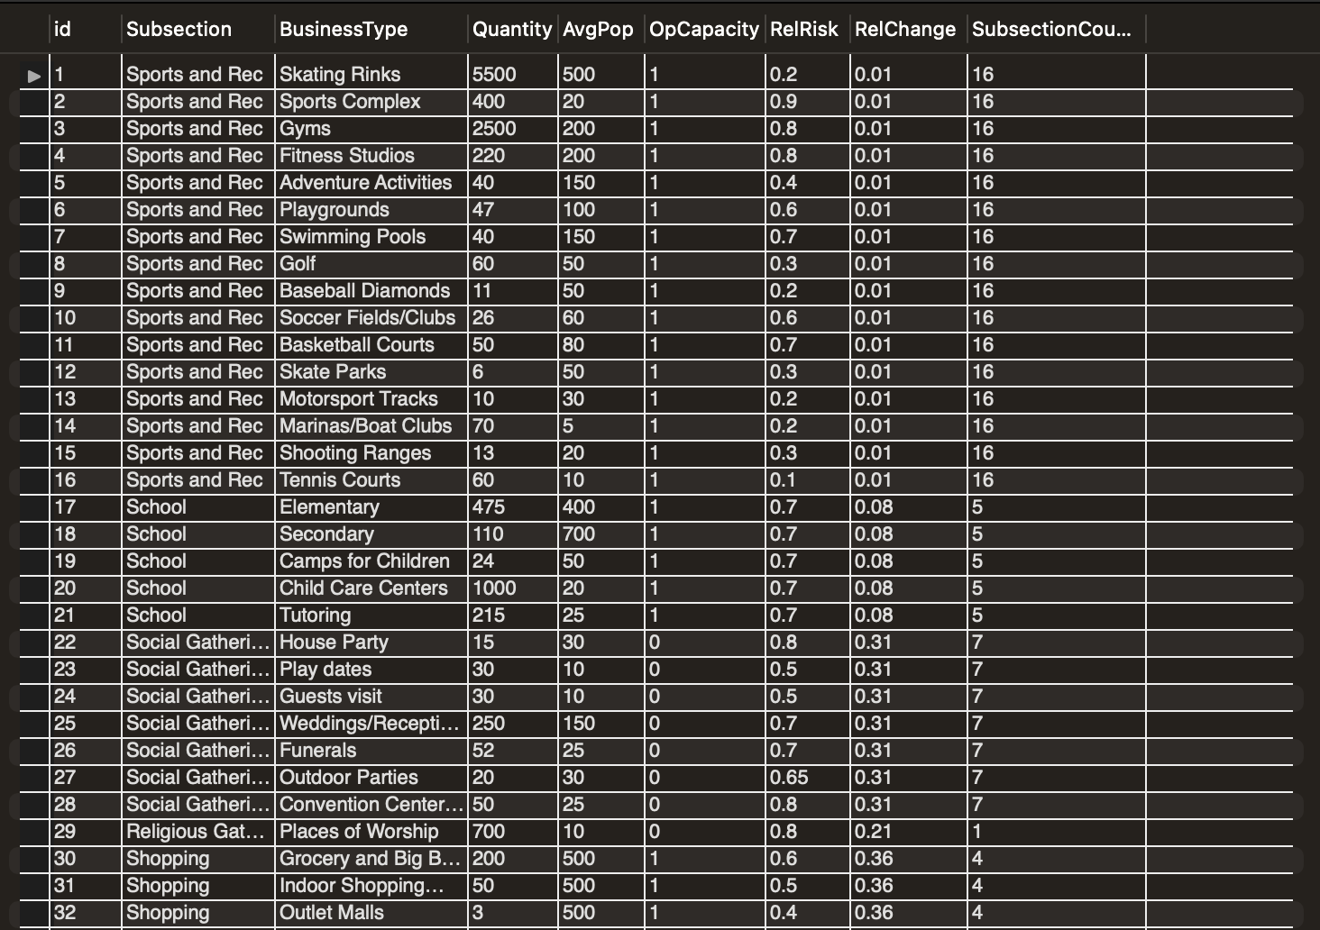
Results (Correlation Data)

Slide 25
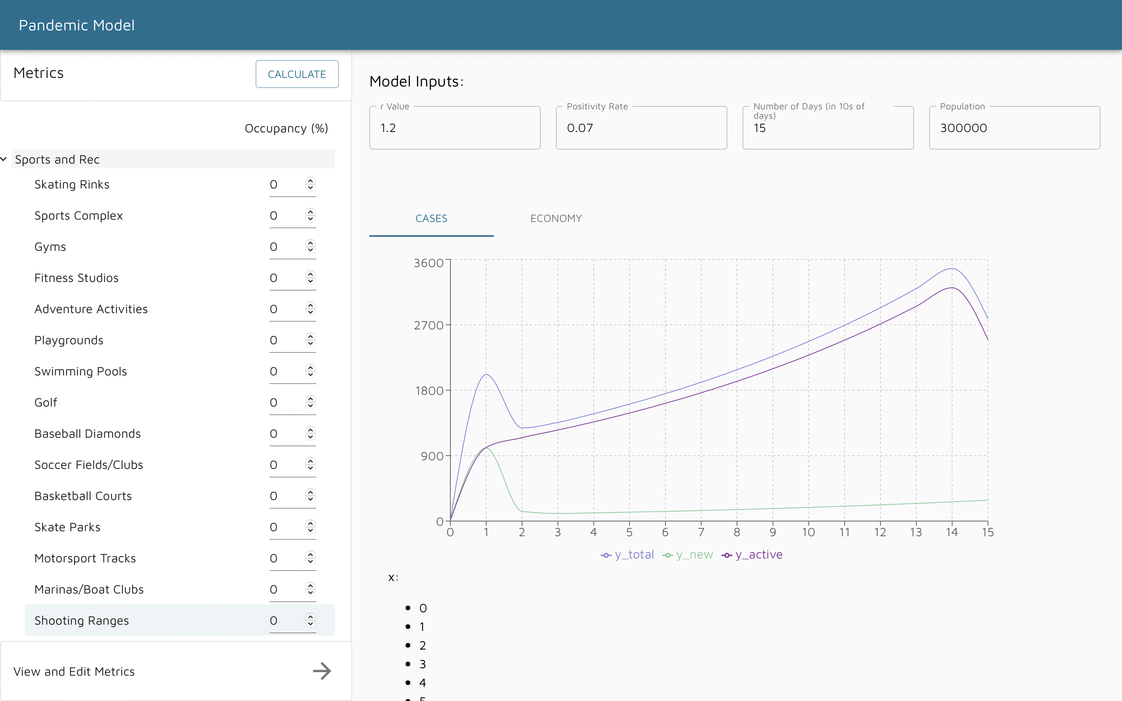
Results (Working Prototype)
Day 0:
It is Calculated from the ML model predictions where the Positivity rate is the prediction
Day 1 – X:
Based on NPIs Parameters and Reproduction Value (r Value)
Day 0
Day 1-X

Slide 26
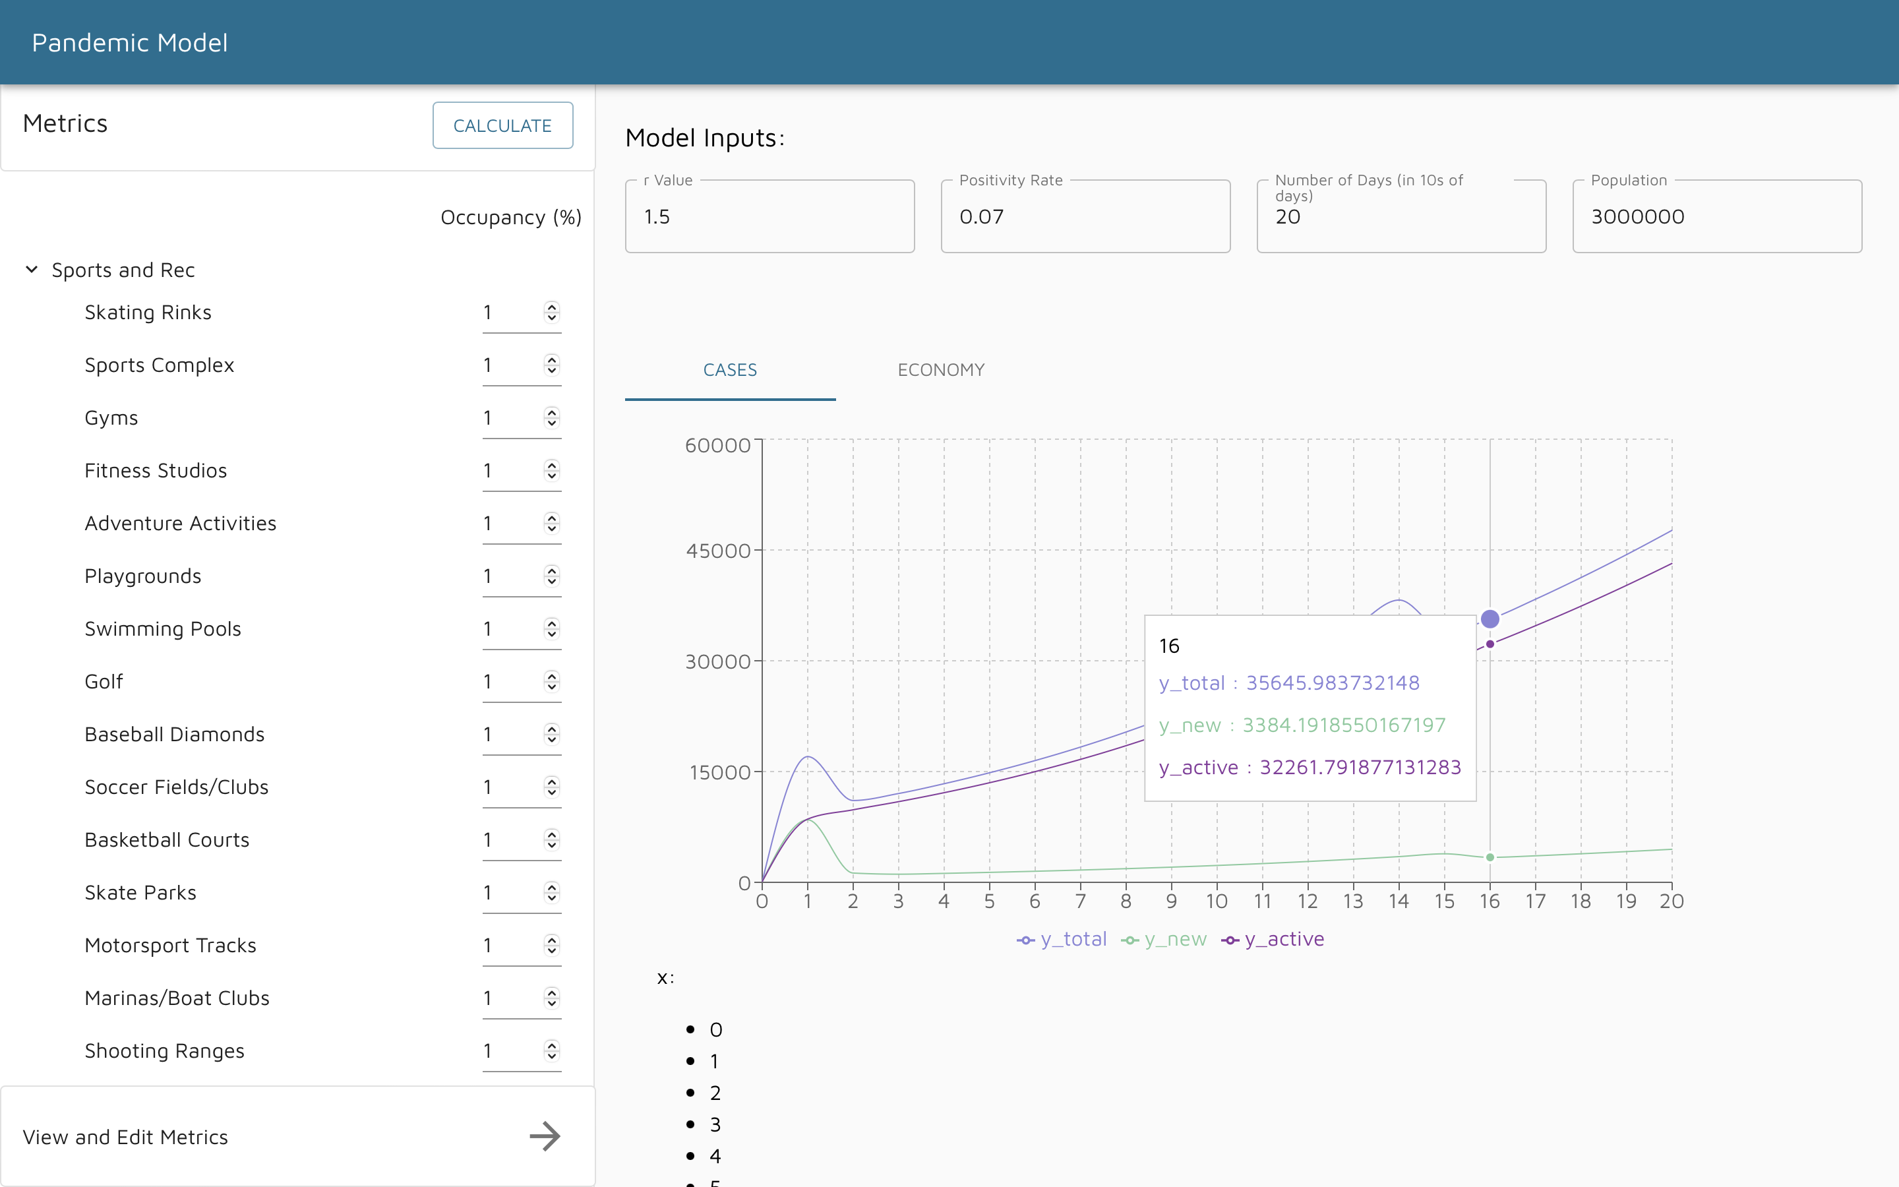
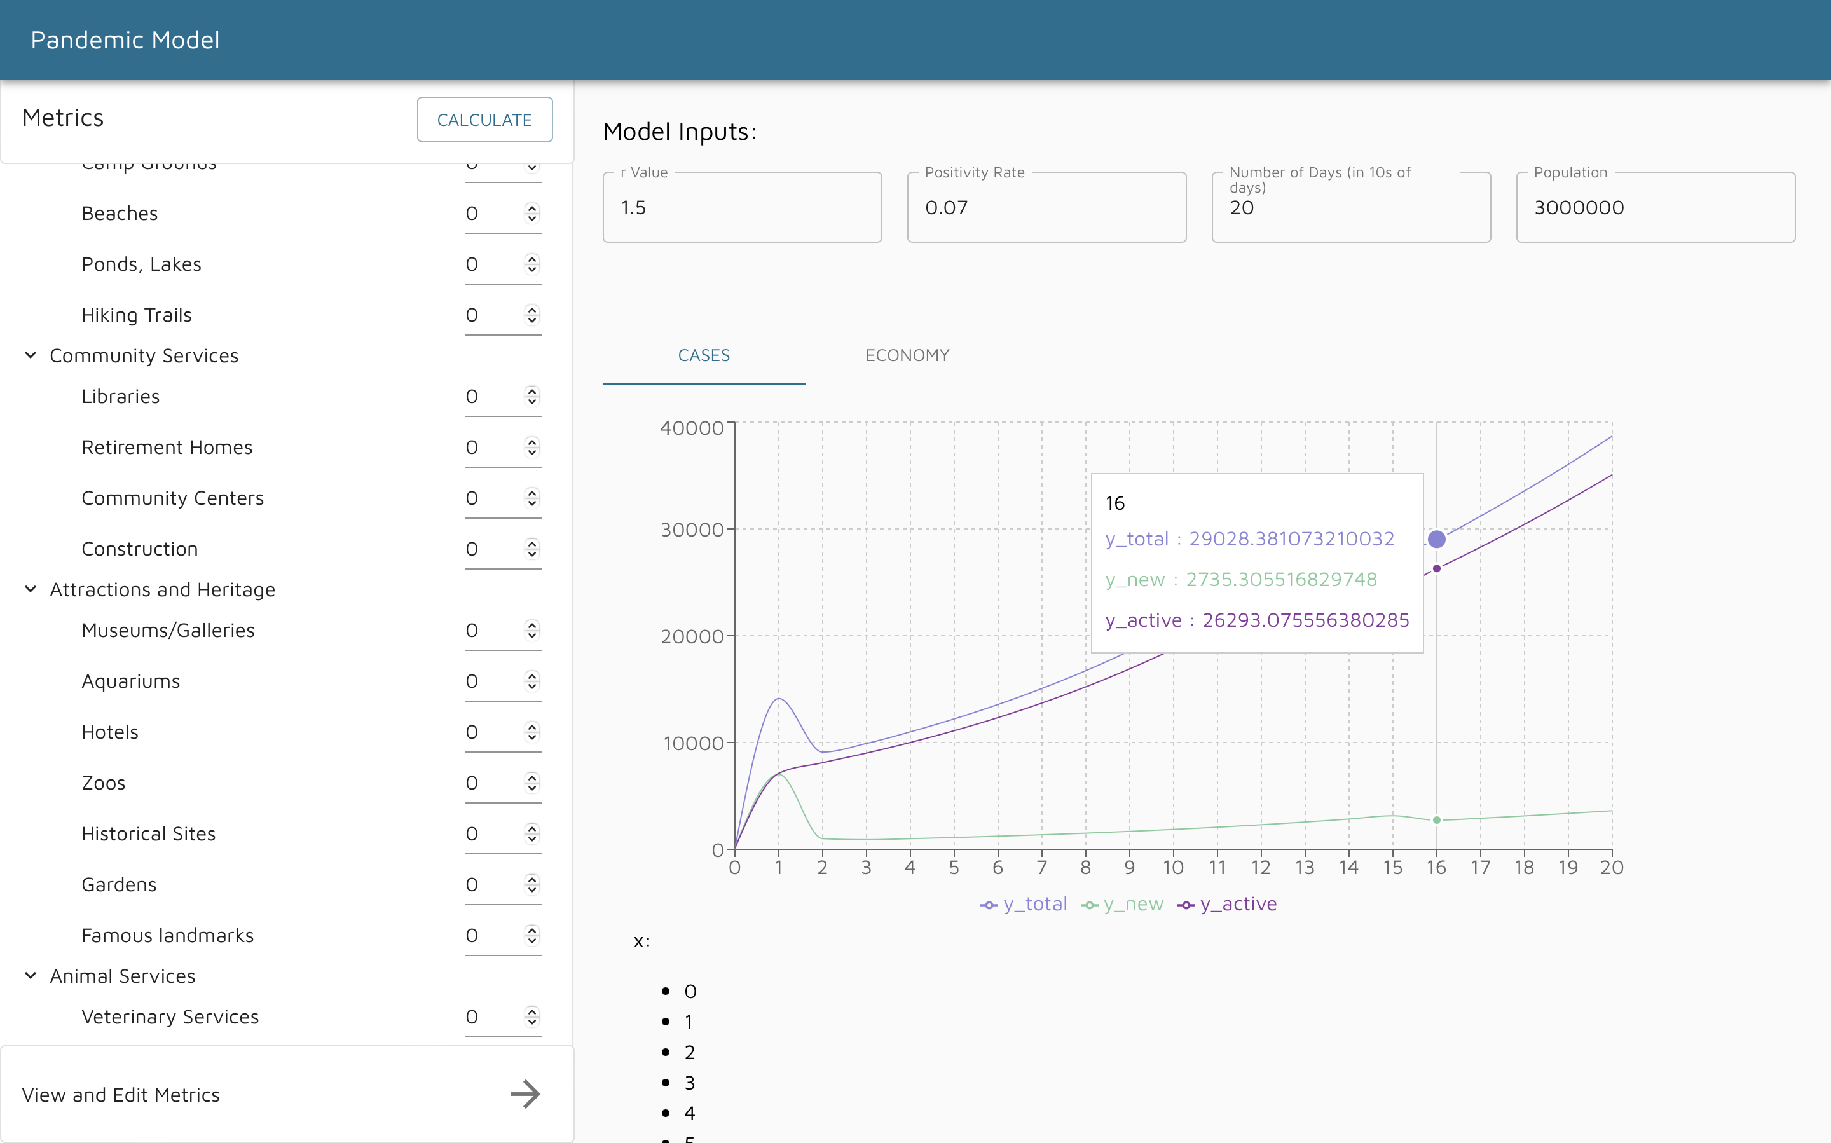
Results (Effect of Correlation Data on Daily New Infection Cases)
When OpCapacity for all NPIs is 1%
When OpCapacity for all NPIs is 0%

Slide 27
Limitations

Slide 28

Limitations
The dataset contains only samples from Canada. Different countries can have different strategy against COVID-19
Not much research done on some NPIs such as Nature and Camping and their correlation with infection rates.
For a working prototype of the project, lots of assumptions have been made that might prevent the model from giving accurate results.

Slide 29
Validation

Slide 30

Validation
The graphical output of this prototype can be validated through comparing it against the historical COVID-19 daily new infection cases.

Slide 31
Future Work

Slide 32
Future Work and Lesson Learnt
Future Work
Currently, this tool is only focussing on Canada which can be expanded by gathering the whole world dataset and then integrating that dataset into our existing prototype which can eventually forecast the impact of the different lockdown measures on the spread of COVID-19 infections over the entire world.
Lessons Learnt
Using real-world historical data to create models or applications is a great way to create meaningful applications and tools.
More data the better for training models.

Slide 33
Conclusion

Slide 34
Conclusion
Project objective
The pandemic model tool is now a working prototype
Results obtained
Policymakers will have a strong tool that can allow them to make highly informed strategic decisions to balance between NPIs and public health
The tool is:
Easy to use and useful tool for policymakers
Visualization of impact on infection cases
Easily scalable for future pandemics
From using the tool, it’s clear that NPIs can have a great impact on public health, it’s important to study the effect of different occupancy restrictions on various NPI to find the optimal solution for the public.

Slide 35
Thank You

